Slide 1
Algorithms and Data Structures (CIS1002-N)
Week 6: Doubly-Linked Lists and Circular-Linked Lists
Module Leader: Dr Annalisa Occhipinti
Email: A.Occhipinti@tees.ac.uk

Slide 2

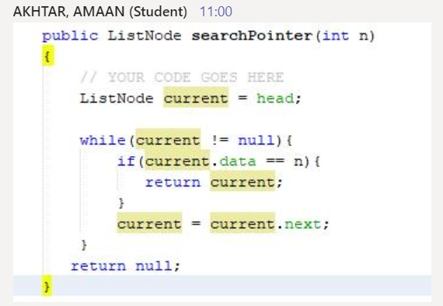
Homework: Exam Question. Search for a value
You should assume that the list is not ordered.

Slide 3
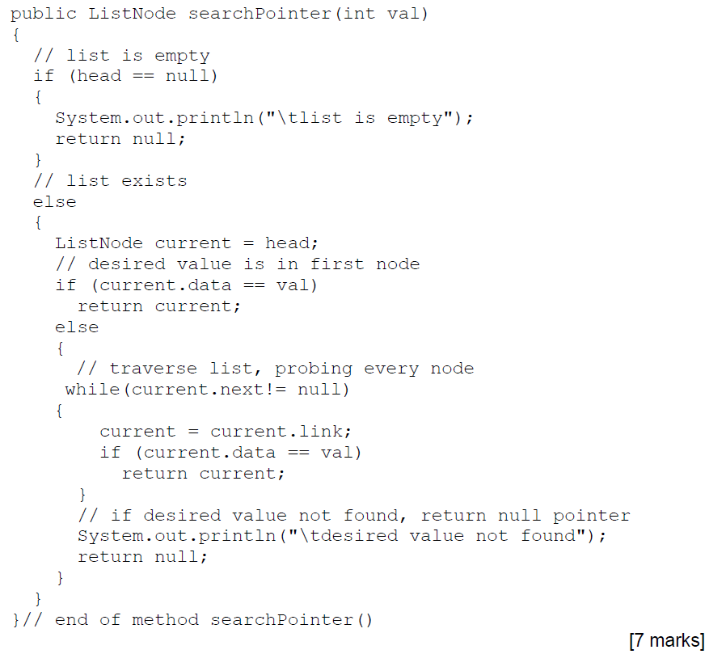
This is just one possible answer.
Make sure you add comments in your code.

Slide 4


Last week’s quiz
Well done!

Slide 5
Doubly Linked Lists
null
A
B
C
null
Head

Slide 6
Variations of Linked-Lists
Doubly linked-lists
Each node points to not only its successor but also its predecessor
There are two null: at the first and last nodes
Advantage: given a node, it is easy to visit its predecessor.
Sometimes convenient to traverse lists backwards
null
A
B
C
null
Head

Slide 7
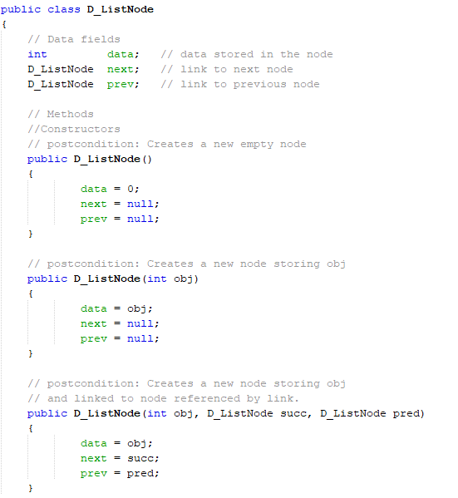
Constructors – DoublyLinkedListNode

Slide 8
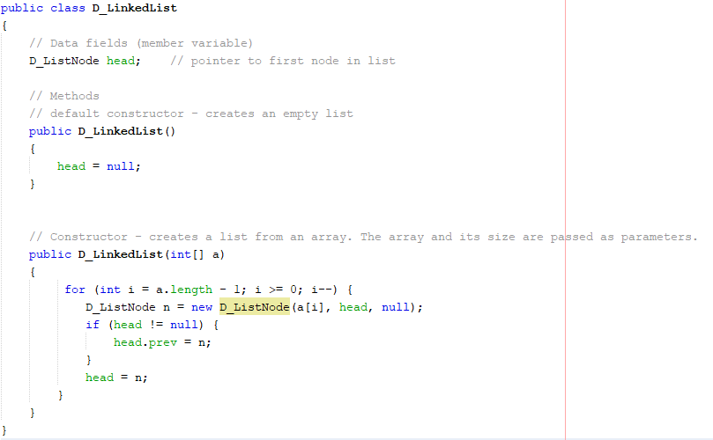

Slide 9
Doubly linked-list
Operations
Initialise the list
Determine whether the list is empty
Print the list
Destroy the list
Search the list for a given item
Retrieve the first element of the list
Retrieve the last element of the list
Insert an item in the list
Delete an item from the list
Find the length of the list

Slide 10
Doubly linked-list – 4 Quick Questions
How would you implement the following methods?
1) Determine whether the list is empty or not. | 2) Retrieve the first element of the list, return -1 if the list is empty.
3) Retrieve the last element of the list, return -1 if the list is empty. | 4) void deleteLast(int value) Delete the element at the end of the list
∅
1
3
8
9
∅
Head
Current

Slide 11
Inserting a new node
(At least) four possible cases:
Insert into an empty list
Insert in front
Insert at back
Insert in middle
But, in fact, we only need to handle two cases
Insert as the first node (Case 1 and Case 2)
Insert after another node (Case 3 and Case 4)

Slide 12
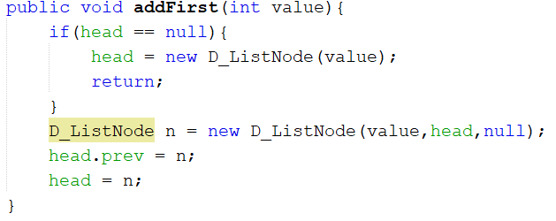
Insert at the beginning of the list
null
5
null
1
3
8
9
null
n
Head
Head

Slide 13
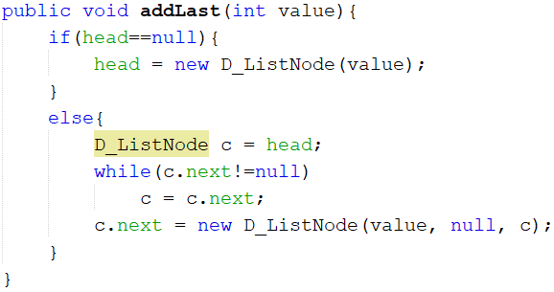
Inserting at the end
null
1
3
8
9
null
value
null
Head
c

Slide 14

Inserting in the middle
Four links to be attached:
5
∅
1
3
8
9
∅
Head
Current

Slide 15
Inserting in the middle
Four links to be attached:
5
∅
1
3
8
9
∅
Head
Current

Slide 16
Inserting in the middle
Four links to be attached:
5
∅
1
3
8
9
∅
Head
Current

Slide 17
Inserting in the middle
Four links to be attached:
5
∅
1
3
8
9
∅
Head
Current

Slide 18
Inserting
The insertion of a node in the list requires the adjustment of 2 reference-variables/pointers either side.
Case 1: the list is empty
Case 2: insertion at the beginning of a non-empty list
Case 3: insertion at the end of a non-empty list
Case 4: insertion somewhere in a non-empty list

Slide 19
Insert at the beginning of the list

Slide 20
Inserting at the end

Slide 21
2 Other Ways of inserting a new node
Inserting a new node at a specified position / index :
boolean insertAtIndex(int index, int value)
Inserting a node after a node storing a given value :
int insertAfterValue(int value, int searchvalue)
… and returning the node’s position

Slide 22
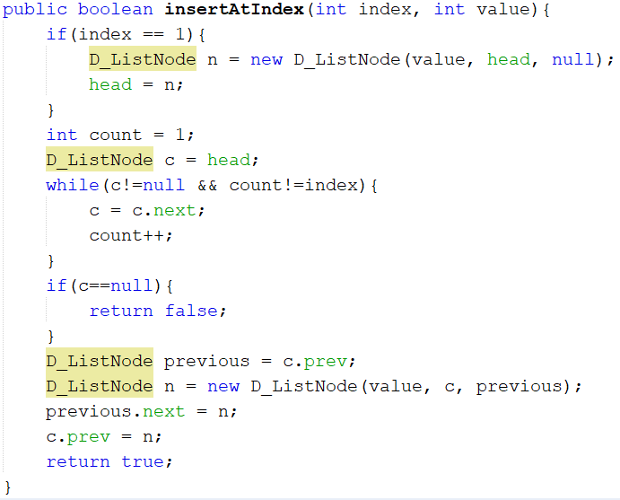

Slide 23
Inserting a new node at a specified position
boolean insertAtIndex(int index, int value)
Specify index where new node with value is to be inserted (1-index based system).
boolean type, so return value will either be true or false.
Try to locate index^{th} node: if found, mark current node.
If index invalid or not found before reaching end of list, return false.
Create a new node.
if index is 1, insert as first element.
Otherwise, insert after marked node.

Slide 24
Write the Java code for the method below Inserting a node after a node storing a given value
int insertAfterValue(int value, int searchvalue)
Specify searchValue after which new node with value is to be inserted.
int type, so return value will be position of new node in list.
Search for the first node containing searchvalue, keeping a count of its position in the list.
May reach end of list and not find searchvalue,then return sentinel value (-1).
Create new node.
Insert and return position in list.

Slide 25
Doubly Linked Lists VS Singly Linked Lists
Pros of DLL | Cons of DLL
Easier to insert elements: We can always access both the previous and the next elements to perform reference-variable/pointer re-assignment. | Memory usage: Extra overhead per element (extra reference-variable/pointer) when compared to a singly linked-list.
Easier to delete elements: Stepping through a singly linked-list and removing elements, you have to keep track of the previous element. | Complex Implementation: The node contains some data and a pointer to the next as well as the previous node in the list
Time Complexity: In case of doubly linked list the complexity of insertion and deletion at a known position is O(1), compared to O(n) in Singly Linked List. | Time Complexity: However, more pointer operations are required than in a singly linked list.

Slide 26
Homework:
Inserting a node in an ordered singly linked list.
public void insert(int entry)
To insert an item:
Find the place where the new item is supposed to go,
Insert the item in the list.
2 Cases to consider:
Case 1: the list is initially empty.
Case 2: the new item is smaller than the smallest item in the list.

Slide 27
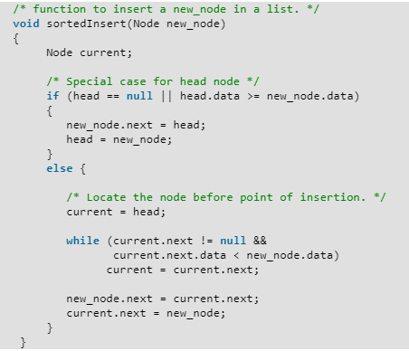

Slide 28
Quiz

Slide 29
Homework: Write the Java code for the method below Inserting a node after a node storing a given value
int insertAfterValue(int value, int searchvalue)
Specify searchValue after which new node with value is to be inserted.
int type, so return value will be position of new node in list.
Search for the first node containing searchvalue, keeping a count of its position in the list.
May reach end of list and not find searchvalue,then return sentinel value (-1).
Create new node.
Insert and return position in list.

Slide 30
Summary
Reviewed linked-lists.
Extended knowledge of linked-lists:
Ordered linked-lists
Doubly linked-lists
Circular lists
Next lesson: List of Lists

